Slide 1
Inside ChatGPT
What’s Transformer architecture?

Slide 2
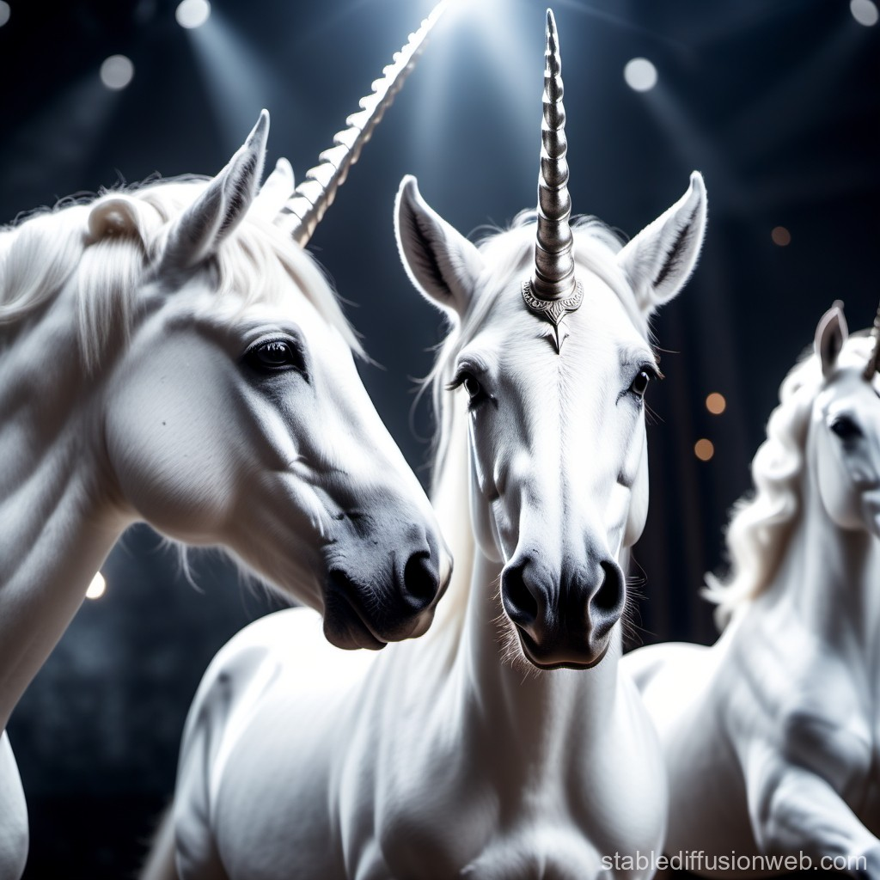
A little bit about me..
Emilia Zawadzka-Gosk
zawadzka.emilia@gmail.com
Data Engineer
@PKO Faktoring
ML/AI enthusiast
since 2011 I am a data person
2018-2024 lecturer and researcher
@PJAIT

Slide 3
Agenda
This presentation is for you if:
you know the basics of neural network
and you are curious what Transformer is
1
2
3
4
Transformer in details
Attention
GPT-2
Having fun :)
tuning GPT-2

Slide 4
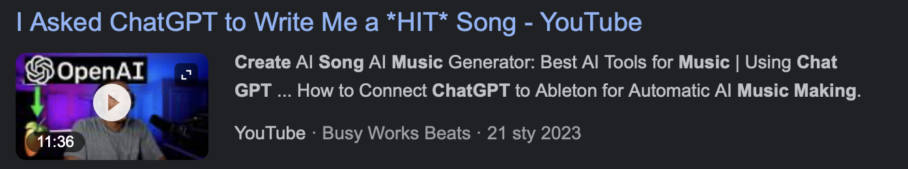
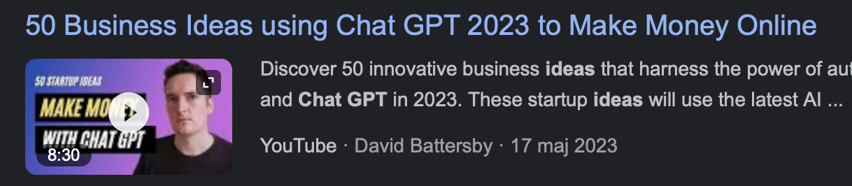
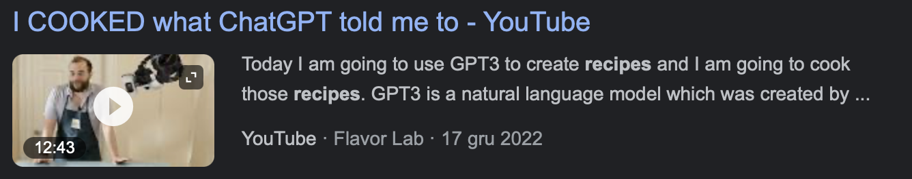
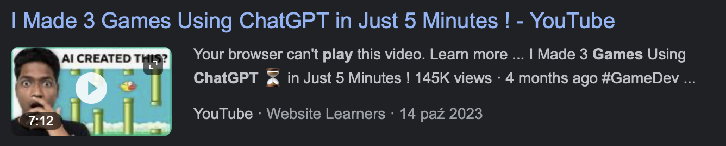
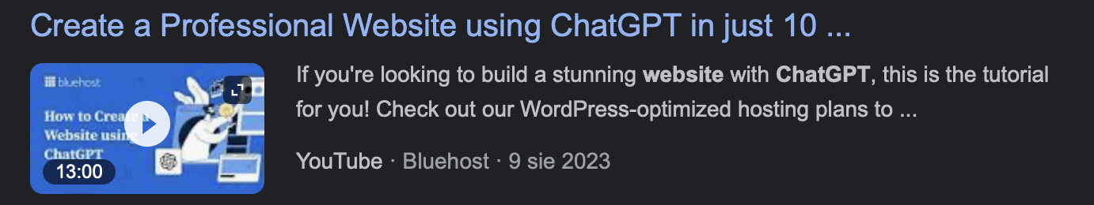
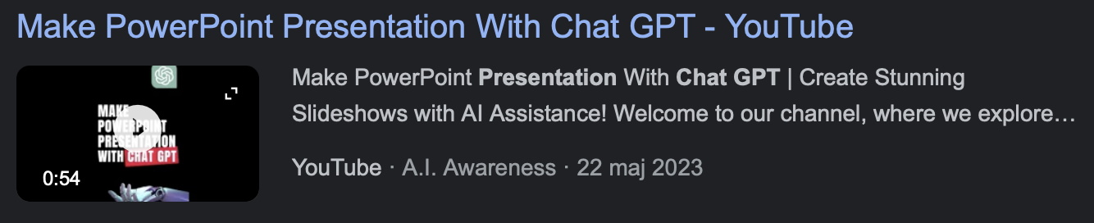
ChatGPT

Slide 5
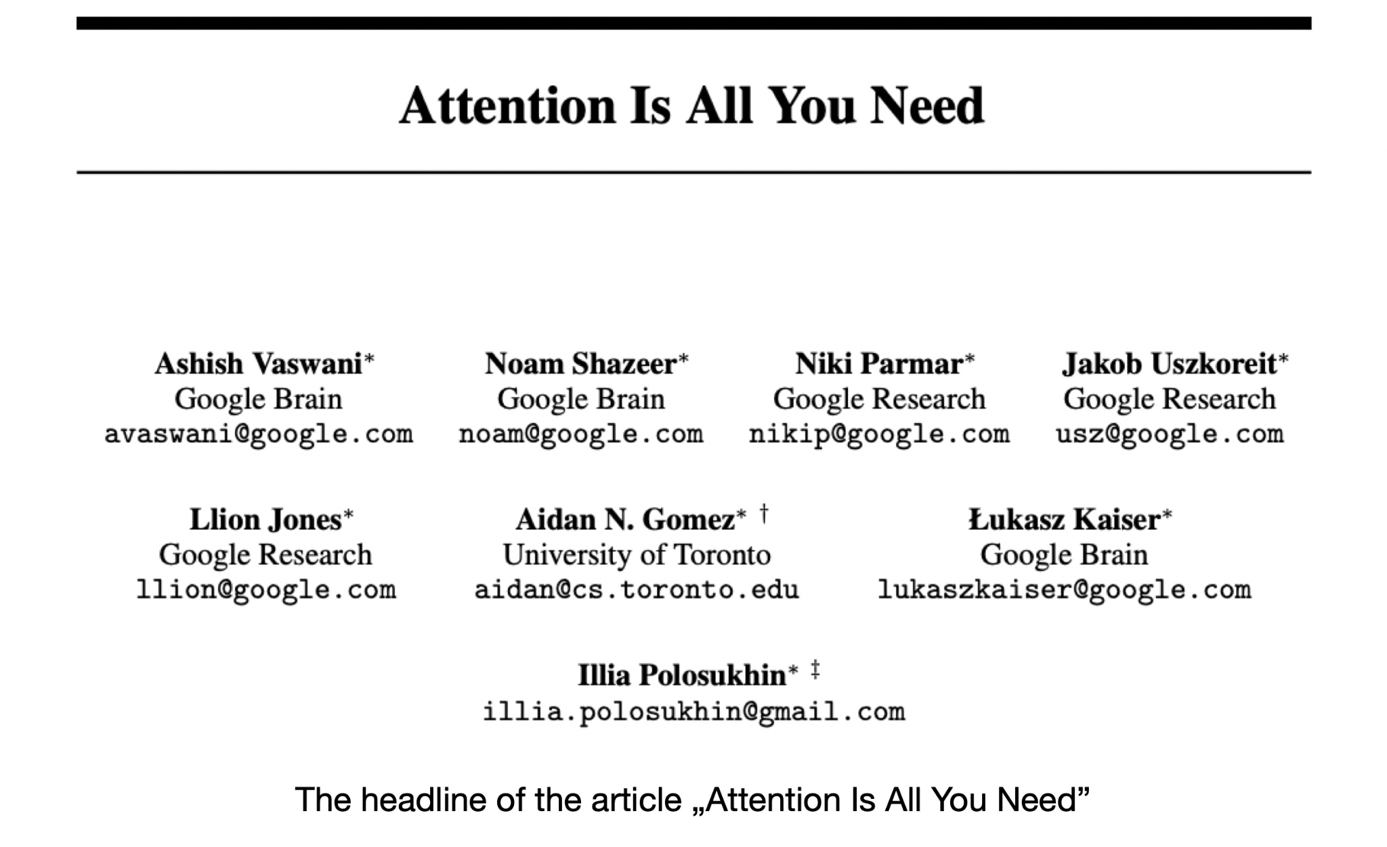
How it started
Notes:
introduced in 2016
the Transformer architecture started to be used and evolves

Slide 6
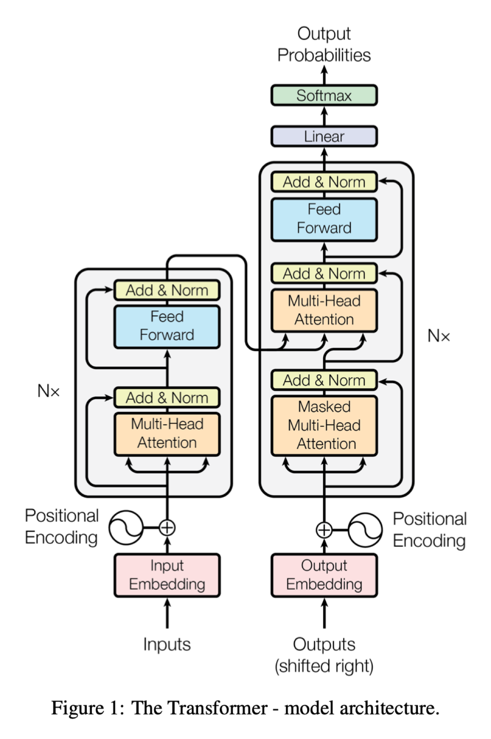
Transformer
architecture
Notes:
initially for seq2seq, machine translation
text -> tokens -> embeddings -> thru the neural network ->
as the output -> predictions -> finding nearest tokens in embedding space -> convert into text

Slide 7
Encoder
Notes:
First part, encoder.
To compute internal states -> translate human way of understanding natural language into math model (computer way of understanding language)

Slide 8
Encoder
Notes:
few 12-100 encoder layer
each attention layer and feed forward layer
-outpu is send to the decoder

Slide 9
Decoder
Notes:
aim of the decoder is to generate next word (token)
takes information from encoder and previous tokens

Slide 10
Decoder
Notes:
build similar as encoder
12 - 100 decoder layers
each decoder layer: in encoder-decoder version it has two attention layers

Slide 11
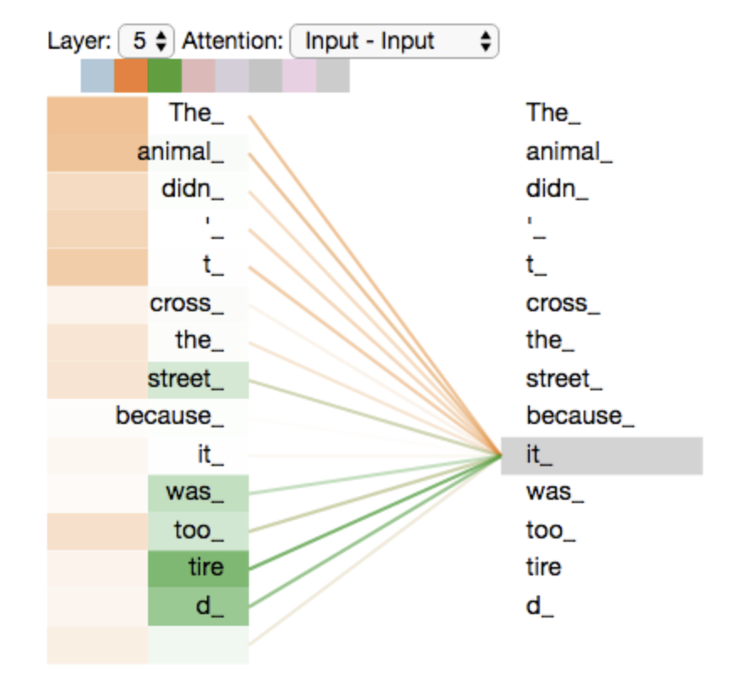
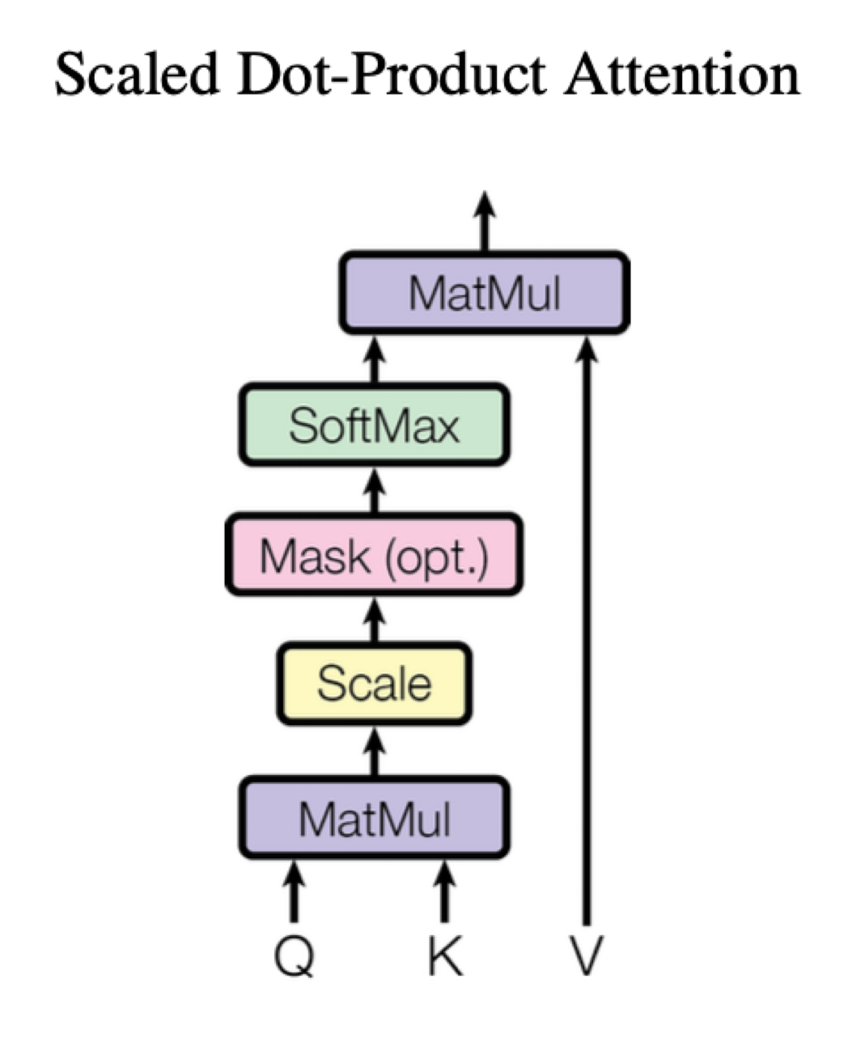
Attention
[2]
Notes:
find the strength of relationships in between words in the text sequence
as in example
intuition behind it: search in a database
in reality: math computation using Q, K, V matrix to calculate attention score

Slide 12
Training objective
Mask some percentage of the input tokens at random and then predict those masked tokens.
Next sentence prediction: In every sample there are two sentences: A nad B. Model needs to predict if B follows A.
Notes:
initially was trained on a two tasks
meaning is coherent

Slide 13
Transformer Architecture: My Project Experience

Slide 14
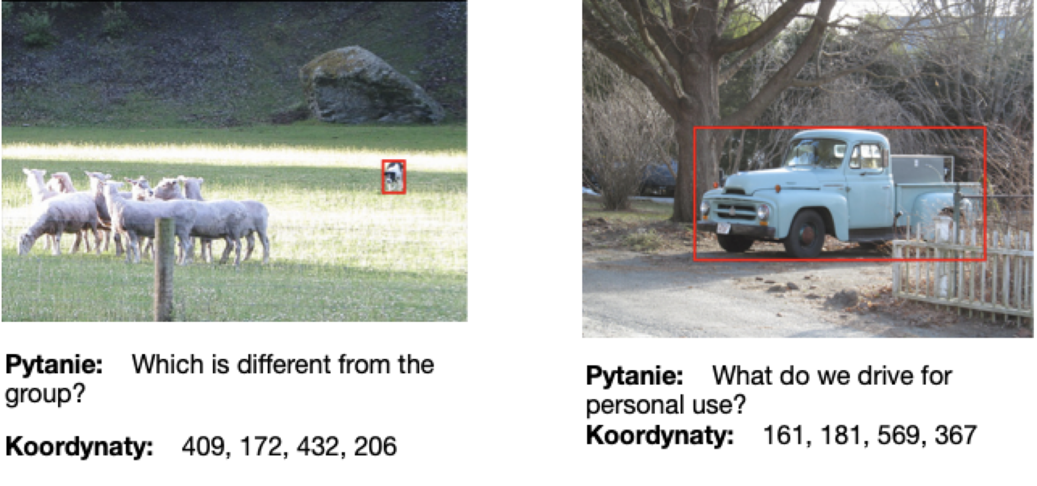
Visual Question Answering Project (2023)
Notes:
set of pairs: question and related image
did not have big computational resources to train multimodal model
did not want to use any paid service
me and my supervisor came with an idea of three stage project

Slide 15
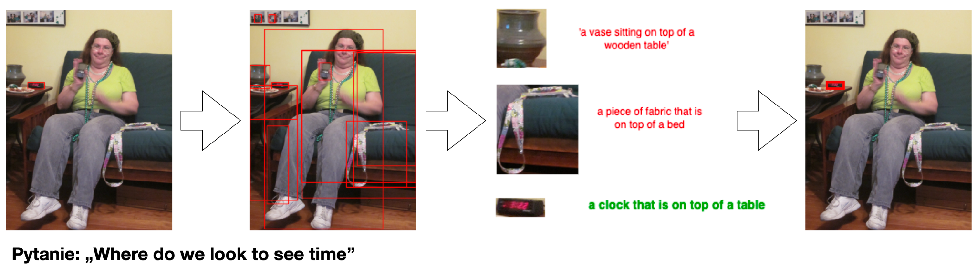
Visual Question Answering Project (2023)
Notes:
object detection
image captioning: described all detected areas
most important stage: LM needs to decide if the description contains the answer to the question

Slide 16
Experiment
Example 1
A: What animal is fluffy and furry?
B: the cat sleeps on a windowsill;
Answer: yes
Example 2
A: What can be used to cut bread?
B: a person on a bike;
Answer:no

Slide 17

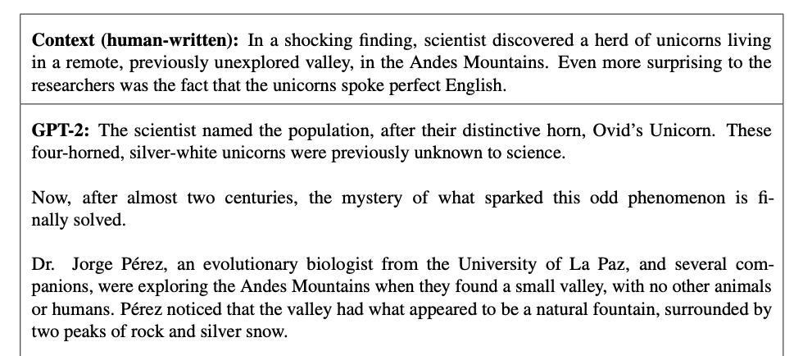
The ancestor: GPT-2
[3]
Notes:
introduced in 2019
decoder only architecture
absolutely the best LM back then
I was surprised. The result was amazing to me. It generated a coherent story about unicorns in natural language.
I did the research on text generation and my results were not even close to GPT-2

Slide 18
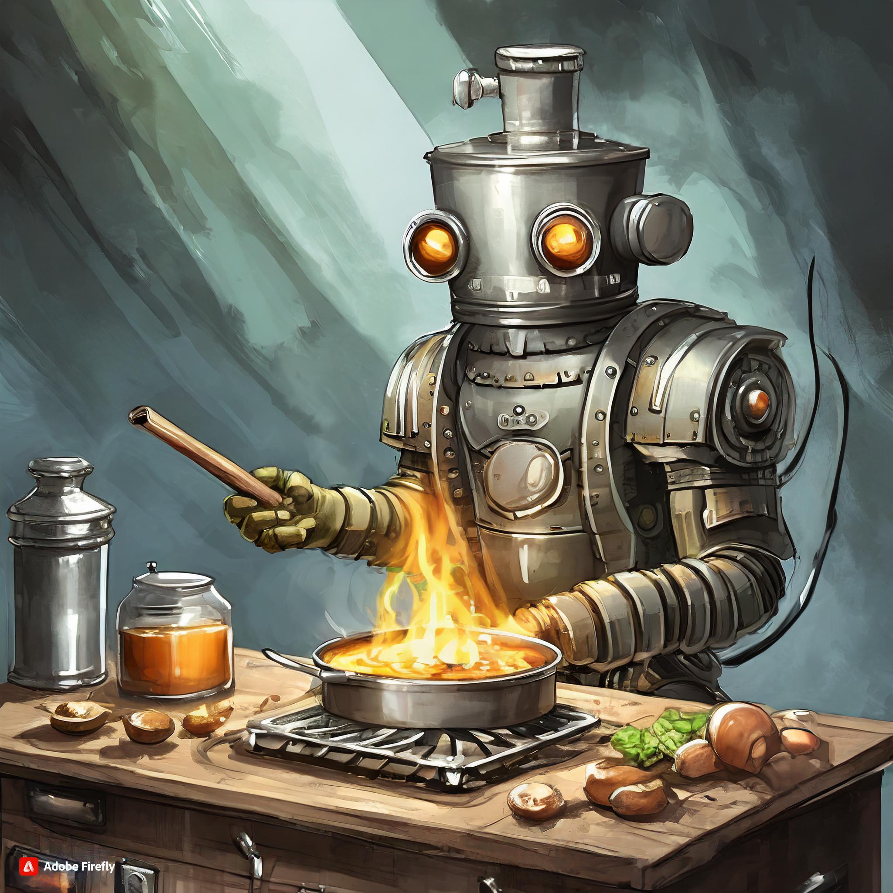
Fine-tuning
Train the entire model
Train only the part of it (e.g. last layer)
Notes:
adapting pre-trained language model to our needs
training it only a little to preserve model abilities, not to ruin the parameters.

Slide 19

Prompt-tuning
Freeze the model.
Concatenate trainable vector (soft prompt) at the beginning of your prompt.
Train the vector.
Use it at inference time.
Soft prompt
Prompt
Notes:
Prompt-tuning is as you expect the process of training a prompt.
text -> token list -> embeddings -> concatenate soft-prompt

Slide 20
Results of my experiment
Accuracy
“Manual” prompt without examples | 0%
“Manual” prompt with 4 examples | 18.7%
Prompt tuning | 77%
Fine-tuning | 81.9%
https://github.com/zawemi/PW

Slide 21
Valuable resources
1. Attention is all you need. https://arxiv.org/pdf/1706.03762.pdf
2. Illustrated Transformer: http://jalammar.github.io/illustrated-transformer/
3. Language Models are Unsupervised Multitask Learners.
https://d4mucfpksywv.cloudfront.net/better-language-models/language_models_are_unsupervised_multitask_learners.pdf
4. Prompt tuning: https://huggingface.co/docs/peft/conceptual_guides/prompting
5. Fine-tuning: https://huggingface.co/docs/transformers/training

Slide 22
Thank you :)

